Slide 1
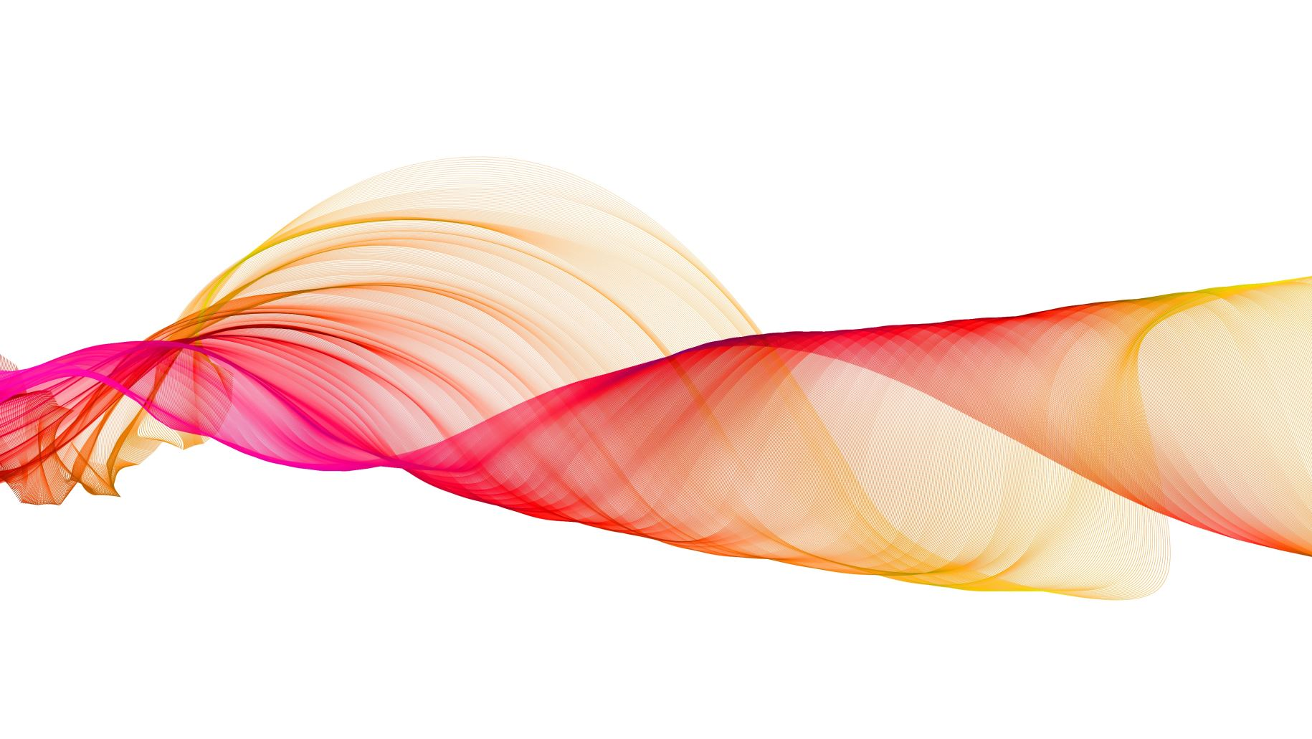
Lab 1
Marinos Rrapaj, Brendan J Magdamo, Stephanie Scheerer, Jonathan Oberst

Slide 2
Model Description
For one of our models, we used k-nearest neighbors to train and fit the data. Using a k=7 value gave us an 84% accuracy without overfitting the data, since there is not that much to start with
Trying out different parameters as well resulted in similar accuracy so we felt that it was the best we can achieve with this model.
Our original model was a support vector machine that used an RBF kernel. This model achieved up to 80% accuracy with a weighted F1 score of about 0.7. This model is only slightly more accurate than just predicting 1 for every test case.

Slide 3
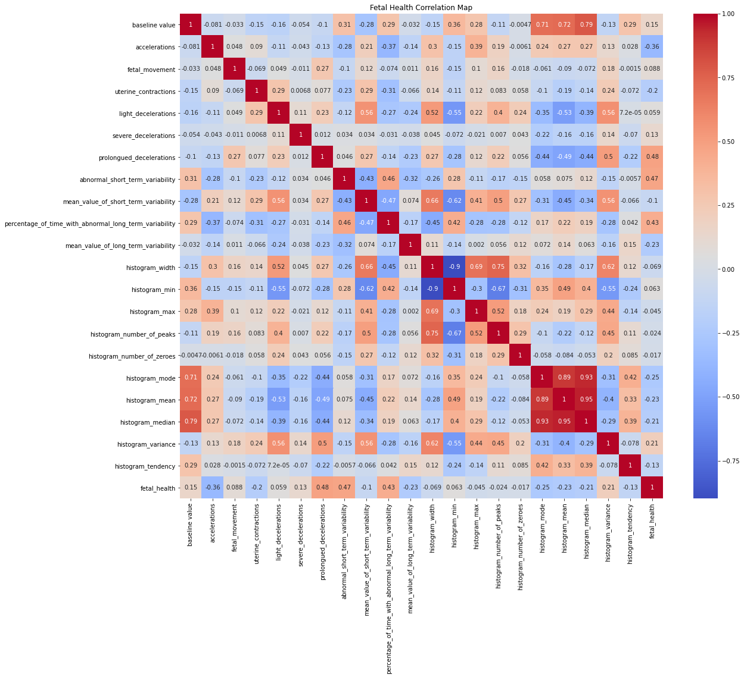
Visualization
Correlation heatmap showing which of the
features are more correlated to fetal_health
at the bottom.

Slide 4
Link
https://github.com/Inceptix/CIS-4496-Project1

Slide 5
Challenges Faced
Getting everyone connected to the GitHub repo
Creating a feasible model
Figuring out how to allow push access
Plotting some of the visuals for the models

